Slide 1


HTML

Slide 2
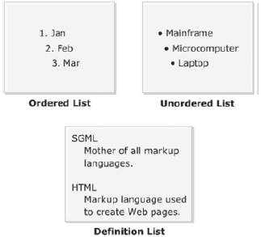
LIST
Can contain paragraphs, images, links, and other lists
Is a collection of items
Displays a list of related items
Can be organized in sequential or nonsequential manner

Slide 3
Types of List
LIST
Ordered
Un-Ordered
Definition

Slide 4
Ordered List
list-style-type property is used to specify a numbering style for the ordered list.
<ol>
<li> </li>
<li> </li>
<li> </li>
</ol>
^{Property’s Value} | ^{Example}
^{decimal} | ^{1, 2, 3…}
^{lower-alpha} | ^{a, b, c…}
^{upper-alpha} | ^{A, B, C…}
^{lower-roman} | ^{i, ii, iii…}
^{upper-roman} | ^{I, II, III…}

Slide 5
Un-ordered List
Items are arranged in random order
The list-style-type property specifies the type of bullet to be applied to an unordered list.
There are three types of bullets defined for the unordered lists:
Disc------------------------------------------default
^{Square}
^{circle}
Syntax:
<ul>
<li> </li>
<li> </li>
<li> </li>
</ul>

Slide 6
Definition List
Refers to a collection of terms with their corresponding descriptions
Contains the terms along with their descriptions
Appears with the term indented on the left followed by description on the right or on next line
Syntax:
<dl>
<dt> </dt>
<dd> <dd>
</dl>
dl - definition List
dt - definition Term
dd - definition Description

Slide 7
Hyperlinks
A hyperlink is referred to as a link, linking to another Web page or to a section in the same Web page.
The A (anchor) element is used to create a hyperlink.
One can specify a text or an image as a hyperlink.
When mouse is moved over such content, the cursor changes into a hand with its index finger pointing towards the content.
This means that clicking the link will take the user to the respective link.
Syntax:
<a href=“link” > </a>

Slide 8
Attributes of <a> </a> tag
^{Property} | ^{Value}
^{href} | ^{Link}
^{target} | _blank To Open Link in new Tab _self Default value:open link in same tab _top To Scroll page to top
^{title} | ^{Title for the link}

Slide 9
Link
Phone
<a href=“ tel:9999999999 “ > Call </a>
Email
<a href=“ mailto:info@gmail.com ” > Mail</a>
Link to any page
<a href=“ abc.html ” > HOME </a>

Slide 10
How to insert images
Syntax:
<img src=“path” />
.png
.jpg
.jpeg
.webp
The <img> tag is used to embed an image in an HTML page.
The <img> tag is standalone tag or self closing tag
Attributes
Attribute | Value | Description
alt | text | Specifies an alternate text for an image
height | pixels | Specifies the height of an image
src | URL | Specifies the path to the image
width | pixels | Specifies the width of an image

